Slide 1
Group Meeting (43)
Advisor: Prof. Liang-Jenq Leu
Student: Yi Lu

Slide 2
10F model (50% Story drift)
case 1
(多個反應譜)
story | 直接積分 | CCQC | Error(%) | GCQC | Error(%)
1 | 0.0055 | 0.0054 | 2.41 | 0.0054 | 2.05
2 | 0.0052 | 0.0052 | 0.04 | 0.0052 | 0.15
3 | 0.0049 | 0.0050 | 0.74 | 0.0050 | 0.50
4 | 0.0046 | 0.0046 | 1.35 | 0.0046 | 1.30
5 | 0.0048 | 0.0049 | 1.44 | 0.0049 | 1.45
6 | 0.0042 | 0.0043 | 1.85 | 0.0043 | 1.88
7 | 0.0035 | 0.0035 | 2.20 | 0.0035 | 2.23
8 | 0.0027 | 0.0027 | 2.52 | 0.0027 | 2.52
9 | 0.0021 | 0.0022 | 2.70 | 0.0022 | 2.64
10 | 0.0011 | 0.0011 | 2.92 | 0.0011 | 2.80
誤差比較(均勻配置)
10F model (90% Story drift)
10F model (100% Story drift)
story | 直接積分 | CCQC | Error(%) | GCQC | Error(%)
1 | 0.0055 | 0.0059 | 1.21 | 0.0059 | 0.89
2 | 0.0052 | 0.0057 | 0.05 | 0.0057 | 0.15
3 | 0.0049 | 0.0054 | 0.21 | 0.0054 | 0.43
4 | 0.0046 | 0.0050 | 0.42 | 0.0050 | 0.47
5 | 0.0048 | 0.0053 | 0.57 | 0.0053 | 0.59
6 | 0.0042 | 0.0047 | 2.61 | 0.0047 | 2.65
7 | 0.0035 | 0.0039 | 2.23 | 0.0039 | 2.26
8 | 0.0027 | 0.0030 | 2.06 | 0.0030 | 2.06
9 | 0.0021 | 0.0024 | 2.12 | 0.0024 | 2.05
10 | 0.0011 | 0.0012 | 2.13 | 0.0012 | 1.99
story | 直接積分 | CCQC | Error(%) | GCQC | Error(%)
1 | 0.0059 | 0.0064 | 4.52 | 0.0064 | 4.20
2 | 0.0057 | 0.0062 | 2.45 | 0.0062 | 2.55
3 | 0.0054 | 0.0059 | 0.88 | 0.0059 | 1.11
4 | 0.0051 | 0.0055 | 0.26 | 0.0055 | 0.21
5 | 0.0053 | 0.0058 | 1.31 | 0.0058 | 1.33
6 | 0.0045 | 0.0051 | 2.33 | 0.0051 | 2.38
7 | 0.0038 | 0.0042 | 3.23 | 0.0042 | 3.27
8 | 0.0029 | 0.0033 | 4.04 | 0.0033 | 4.03
9 | 0.0023 | 0.0026 | 4.52 | 0.0026 | 4.44
10 | 0.0012 | 0.0013 | 4.99 | 0.0013 | 4.82

Slide 3
10F model (0% Story drift)
case 1
(多個反應譜)
story | 直接積分 | CCQC | Error(%) | GCQC | Error(%)
1 | 0.0049 | 0.0049 | 1.70 | 0.0049 | 1.27
2 | 0.0048 | 0.0047 | 0.64 | 0.0047 | 0.77
3 | 0.0045 | 0.0045 | 0.02 | 0.0045 | 0.30
4 | 0.0041 | 0.0041 | 0.26 | 0.0041 | 0.20
5 | 0.0043 | 0.0044 | 1.92 | 0.0044 | 1.93
6 | 0.0037 | 0.0038 | 3.57 | 0.0038 | 3.59
7 | 0.0030 | 0.0032 | 4.75 | 0.0032 | 4.77
8 | 0.0023 | 0.0025 | 5.76 | 0.0025 | 5.76
9 | 0.0018 | 0.0020 | 6.29 | 0.0020 | 6.25
10 | 0.0009 | 0.0010 | 6.85 | 0.0010 | 6.74
誤差比較(均勻配置)
10F model (10% Story drift)
10F model (25% Story drift)
story | 直接積分 | CCQC | Error(%) | GCQC | Error(%)
1 | 0.0051 | 0.0051 | 0.70 | 0.0051 | 0.21
2 | 0.0049 | 0.0049 | 0.15 | 0.0049 | 0.00
3 | 0.0046 | 0.0047 | 0.94 | 0.0046 | 0.64
4 | 0.0042 | 0.0043 | 2.64 | 0.0043 | 2.56
5 | 0.0044 | 0.0045 | 3.46 | 0.0045 | 3.47
6 | 0.0038 | 0.0040 | 4.44 | 0.0040 | 4.45
7 | 0.0031 | 0.0033 | 5.55 | 0.0033 | 5.56
8 | 0.0024 | 0.0026 | 6.37 | 0.0026 | 6.38
9 | 0.0019 | 0.0020 | 6.87 | 0.0020 | 6.84
10 | 0.0010 | 0.0010 | 7.43 | 0.0010 | 7.34
story | 直接積分 | CCQC | Error(%) | GCQC | Error(%)
1 | 0.0053 | 0.0052 | 3.20 | 0.0052 | 2.88
2 | 0.0051 | 0.0050 | 1.41 | 0.0050 | 1.51
3 | 0.0047 | 0.0048 | 0.68 | 0.0048 | 0.46
4 | 0.0043 | 0.0044 | 2.08 | 0.0044 | 2.02
5 | 0.0046 | 0.0047 | 2.79 | 0.0047 | 2.80
6 | 0.0039 | 0.0041 | 3.86 | 0.0041 | 3.89
7 | 0.0032 | 0.0034 | 5.47 | 0.0034 | 5.50
8 | 0.0025 | 0.0026 | 6.27 | 0.0026 | 6.26
9 | 0.0020 | 0.0021 | 6.63 | 0.0021 | 6.57
10 | 0.0010 | 0.0011 | 7.01 | 0.0011 | 6.88

Slide 4
case 1(多個反應譜)
誤差比較(均勻配置)
20F model (90% Story drift)
20F model (100% Story drift)
story | 直接積分 | CCQC | Error(%) | GCQC | Error(%)
1 | 0.0076 | 0.0077 | 1.31 | 0.0078 | 2.16
2 | 0.0075 | 0.0076 | 1.70 | 0.0077 | 2.01
3 | 0.0074 | 0.0075 | 1.96 | 0.0076 | 1.77
4 | 0.0072 | 0.0073 | 1.70 | 0.0075 | 1.26
5 | 0.0083 | 0.0084 | 0.58 | 0.0085 | 0.34
6 | 0.0081 | 0.0081 | 0.57 | 0.0082 | 0.77
7 | 0.0079 | 0.0078 | 1.51 | 0.0079 | 1.64
8 | 0.0076 | 0.0074 | 1.74 | 0.0076 | 1.80
9 | 0.0084 | 0.0082 | 1.75 | 0.0084 | 1.76
10 | 0.0079 | 0.0078 | 1.78 | 0.0079 | 1.76
11 | 0.0074 | 0.0072 | 1.75 | 0.0073 | 1.73
12 | 0.0069 | 0.0067 | 2.76 | 0.0068 | 2.73
13 | 0.0073 | 0.0070 | 3.47 | 0.0071 | 3.45
14 | 0.0066 | 0.0063 | 4.29 | 0.0064 | 4.28
15 | 0.0057 | 0.0055 | 4.44 | 0.0056 | 4.45
16 | 0.0049 | 0.0046 | 4.55 | 0.0047 | 4.57
17 | 0.0046 | 0.0043 | 4.52 | 0.0044 | 4.55
18 | 0.0035 | 0.0033 | 4.57 | 0.0033 | 4.63
19 | 0.0023 | 0.0022 | 4.60 | 0.0022 | 4.68
20 | 0.0012 | 0.0011 | 4.61 | 0.0011 | 4.70
story | 直接積分 | CCQC | Error(%) | GCQC | Error(%)
1 | 0.0079 | 0.0077 | 0.98 | 0.0078 | 0.22
2 | 0.0077 | 0.0076 | 0.47 | 0.0077 | 0.18
3 | 0.0076 | 0.0075 | 0.13 | 0.0076 | 0.32
4 | 0.0075 | 0.0073 | 0.24 | 0.0074 | 0.56
5 | 0.0085 | 0.0083 | 0.47 | 0.0085 | 0.70
6 | 0.0083 | 0.0081 | 0.87 | 0.0082 | 1.05
7 | 0.0080 | 0.0078 | 1.30 | 0.0079 | 1.41
8 | 0.0077 | 0.0074 | 1.71 | 0.0076 | 1.76
9 | 0.0086 | 0.0082 | 2.35 | 0.0084 | 2.36
10 | 0.0082 | 0.0078 | 3.45 | 0.0079 | 3.44
11 | 0.0077 | 0.0072 | 4.45 | 0.0073 | 4.42
12 | 0.0072 | 0.0067 | 5.34 | 0.0068 | 5.32
13 | 0.0076 | 0.0070 | 5.75 | 0.0071 | 5.74
14 | 0.0068 | 0.0063 | 6.45 | 0.0064 | 6.44
15 | 0.0060 | 0.0055 | 7.03 | 0.0056 | 7.03
16 | 0.0051 | 0.0046 | 7.51 | 0.0047 | 7.52
17 | 0.0048 | 0.0043 | 7.50 | 0.0044 | 7.51
18 | 0.0036 | 0.0033 | 7.81 | 0.0033 | 7.83
19 | 0.0024 | 0.0022 | 8.02 | 0.0022 | 8.05
20 | 0.0012 | 0.0011 | 8.14 | 0.0011 | 8.18

Slide 5
case 1(多個反應譜)
誤差比較(均勻配置)
20F model (0% Story drift)
20F model (10% Story drift)
story | 直接積分 | CCQC | Error(%) | GCQC | Error(%)
1 | 0.0057 | 0.0060 | 4.70 | 0.0060 | 1.32
2 | 0.0057 | 0.0059 | 4.65 | 0.0059 | 2.57
3 | 0.0056 | 0.0058 | 4.96 | 0.0058 | 3.79
4 | 0.0054 | 0.0057 | 5.08 | 0.0057 | 4.42
5 | 0.0062 | 0.0065 | 4.25 | 0.0065 | 4.58
6 | 0.0060 | 0.0063 | 3.45 | 0.0062 | 3.83
7 | 0.0058 | 0.0060 | 2.70 | 0.0060 | 3.00
8 | 0.0056 | 0.0057 | 2.07 | 0.0057 | 1.72
9 | 0.0062 | 0.0063 | 1.50 | 0.0063 | 0.18
10 | 0.0059 | 0.0060 | 1.15 | 0.0060 | 1.44
11 | 0.0055 | 0.0056 | 0.91 | 0.0056 | 2.83
12 | 0.0051 | 0.0051 | 0.74 | 0.0051 | 4.04
13 | 0.0054 | 0.0054 | 0.54 | 0.0054 | 4.66
14 | 0.0048 | 0.0049 | 0.48 | 0.0049 | 4.78
15 | 0.0042 | 0.0042 | 0.45 | 0.0042 | 4.45
16 | 0.0036 | 0.0036 | 0.44 | 0.0036 | 4.14
17 | 0.0034 | 0.0034 | 0.39 | 0.0034 | 4.10
18 | 0.0025 | 0.0026 | 0.38 | 0.0026 | 3.88
19 | 0.0017 | 0.0017 | 0.34 | 0.0017 | 3.71
20 | 0.0009 | 0.0009 | 0.32 | 0.0009 | 3.60
story | 直接積分 | CCQC | Error(%) | GCQC | Error(%)
1 | 0.0060 | 0.0061 | 5.78 | 0.0062 | 2.42
2 | 0.0059 | 0.0060 | 5.05 | 0.0061 | 2.99
3 | 0.0057 | 0.0059 | 4.72 | 0.0059 | 3.53
4 | 0.0056 | 0.0058 | 4.66 | 0.0058 | 3.97
5 | 0.0063 | 0.0066 | 3.84 | 0.0066 | 4.27
6 | 0.0061 | 0.0064 | 3.14 | 0.0064 | 3.60
7 | 0.0059 | 0.0061 | 2.50 | 0.0061 | 2.85
8 | 0.0058 | 0.0059 | 1.96 | 0.0058 | 1.65
9 | 0.0065 | 0.0065 | 1.44 | 0.0065 | 0.15
10 | 0.0062 | 0.0061 | 1.10 | 0.0061 | 1.45
11 | 0.0059 | 0.0057 | 0.85 | 0.0057 | 2.84
12 | 0.0055 | 0.0052 | 0.67 | 0.0052 | 4.05
13 | 0.0058 | 0.0055 | 0.50 | 0.0055 | 4.66
14 | 0.0052 | 0.0049 | 0.46 | 0.0049 | 4.78
15 | 0.0045 | 0.0043 | 0.46 | 0.0043 | 4.45
16 | 0.0038 | 0.0037 | 0.48 | 0.0037 | 4.13
17 | 0.0036 | 0.0034 | 0.44 | 0.0034 | 4.09
18 | 0.0027 | 0.0026 | 0.36 | 0.0026 | 3.86
19 | 0.0018 | 0.0017 | 0.31 | 0.0017 | 3.68
20 | 0.0009 | 0.0009 | 0.28 | 0.0009 | 3.57

Slide 6
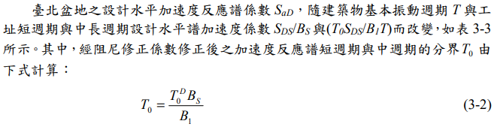
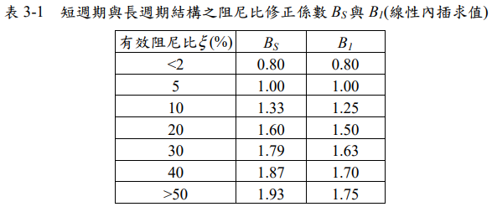
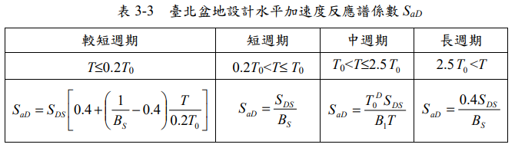

Slide 7
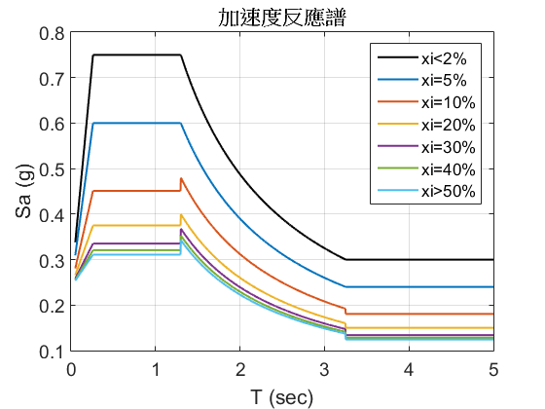
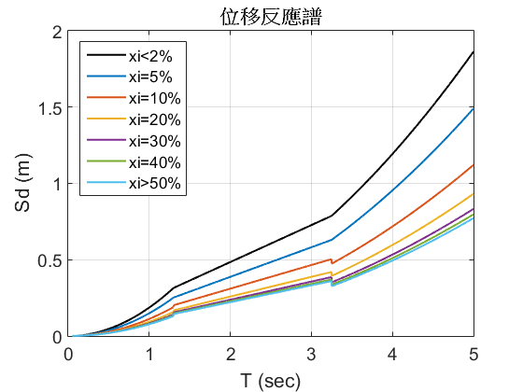
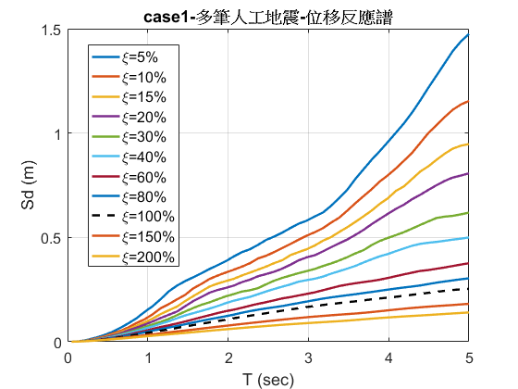

Slide 8
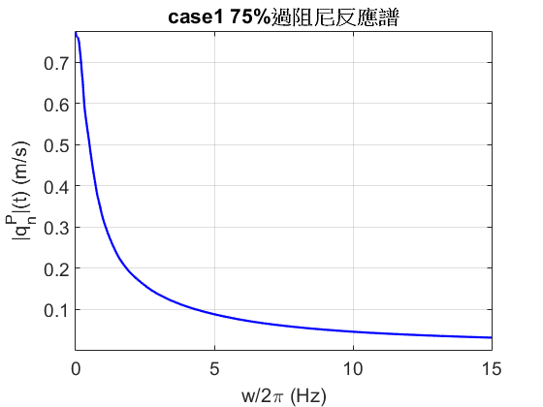
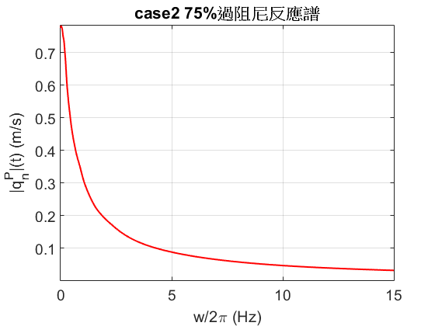
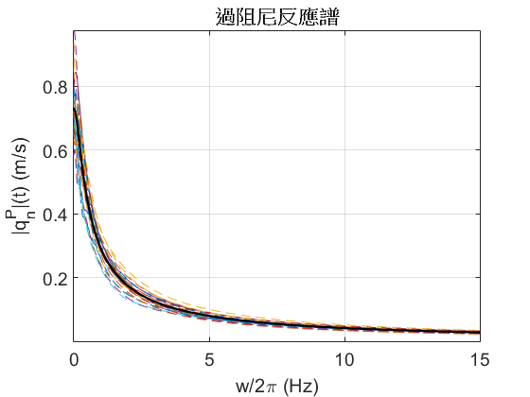
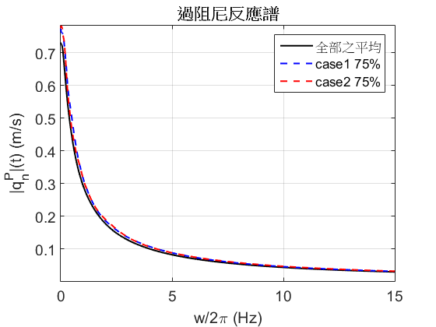

Slide 9
多筆地震最佳化比較
(Case1)(多個反應譜)
用各最佳化結果之配置 以直接積分檢核設計地震之反應
10F | 直接積分 | CCQC | GCQC | 均勻配置
 | 4.565 | 4.707 | 4.801 | 5.669
RI | 19.87 | 15.31 | 16.44
Time(s) | 4092 | 156 | 173
20F | 直接積分 | CCQC | GCQC | 均勻配置
 | 6.869 | 7.080 | 7.076 | 8.146
RI | 16.08 | 13.08 | 13.14
Time(s) | 22340 | 1259 | 1511
30F | 直接積分 | CCQC | GCQC | 均勻配置
 | 8.386 | 7.569 | 7.565 | 8.386
RI | 14.36 | 9.74 | 9.80
Time(s) | 30140 | 3400 | 3737
40F | 直接積分 | CCQC | GCQC | 均勻配置
 | 8.554 | 8.679 | 8.697 | 10.201
RI | 16.19 | 14.96 | 14.79
Time(s) | 38513 | 5195 | 5509

Slide 10
多筆地震最佳化比較
(Case1)(75%反應譜)
用各最佳化結果之配置 以直接積分檢核設計地震之反應
10F | 直接積分 | CCQC | GCQC | 均勻配置
 | 4.565 | 4.669 | 4.707 | 5.669
RI | 19.47 | 17.65 | 16.97
Time(s) | 4092 | 12 | 19
20F | 直接積分 | CCQC | GCQC | 均勻配置
 | 6.869 | 7.071 | 7.081 | 8.146
RI | 15.68 | 13.19 | 13.07
Time(s) | 22340 | 92 | 96
30F | 直接積分 | CCQC | GCQC | 均勻配置
 | 7.182 | 7.515 | 7.528 | 8.386
RI | 14.36 | 10.39 | 10.23
Time(s) | 30140 | 158 | 172
40F | 直接積分 | CCQC | GCQC | 均勻配置
 | 8.554 | 8.789 | 8.807 | 10.201
RI | 16.19 | 13.89 | 14.96
Time(s) | 38513 | 224 | 227

Slide 11
多筆地震最佳化比較
(Case1)(設計反應譜)
用各最佳化結果之配置 以直接積分檢核設計地震之反應
10F | 直接積分 | CCQC | GCQC | 均勻配置
 | 4.565 | 4.718 | 4.767 | 5.669
RI | 19.87 | 16.77 | 15.91
Time(s) | 4092 | 8 | 23
20F | 直接積分 | CCQC | GCQC | 均勻配置
 | 6.869 | 7.317 | 7.120 | 8.146
RI | 16.08 | 10.18 | 12.60
Time(s) | 22340 | 64 | 73
30F | 直接積分 | CCQC | GCQC | 均勻配置
 | 7.182 | 7.671 | 7.453 | 8.386
RI | 14.36 | 8.53 | 11.13
Time(s) | 30140 | 128 | 154
40F | 直接積分 | CCQC | GCQC | 均勻配置
 | 8.554 | 8.729 | 8.680 | 10.201
RI | 16.19 | 14.47 | 14.95
Time(s) | 38513 | 193 | 194

Slide 12
考慮不同反應譜之最佳化比較
Case1
用各最佳化結果之配置 以直接積分檢核設計地震之反應
10F | CCQC 多筆 | GCQC 多筆 | CCQC 75% | GCQC 75% | CCQC 規範 | GCQC 規範
 | 4.707 | 4.801 | 4.669 | 4.707 | 4.718 | 4.767
RI | 15.31 | 16.44 | 17.65 | 16.97 | 16.77 | 15.91
Time (sec) | 156 | 173 | 12 | 19 | 8 | 23
20F | CCQC 多筆 | GCQC 多筆 | CCQC 75% | GCQC 75% | CCQC 規範 | GCQC 規範
 | 7.080 | 7.076 | 7.071 | 7.081 | 7.317 | 7.120
RI | 13.08 | 13.14 | 13.19 | 13.07 | 10.18 | 12.60
Time (sec) | 1259 | 1511 | 92 | 96 | 64 | 73
30F | CCQC 多筆 | GCQC 多筆 | CCQC 75% | GCQC 75% | CCQC 規範 | GCQC 規範
 | 7.569 | 7.565 | 7.515 | 7.528 | 7.671 | 7.453
RI | 9.74 | 9.80 | 10.39 | 10.23 | 8.53 | 11.13
Time (sec) | 3400 | 3737 | 158 | 172 | 128 | 154
40F | CCQC 多筆 | GCQC 多筆 | CCQC 75% | GCQC 75% | CCQC 規範 | GCQC 規範
 | 8.679 | 8.697 | 8.789 | 8.807 | 8.729 | 8.680
RI | 14.96 | 14.79 | 13.89 | 14.96 | 14.47 | 14.95
Time (sec) | 5195 | 5509 | 224 | 227 | 193 | 194

Slide 13
END

Slide 14
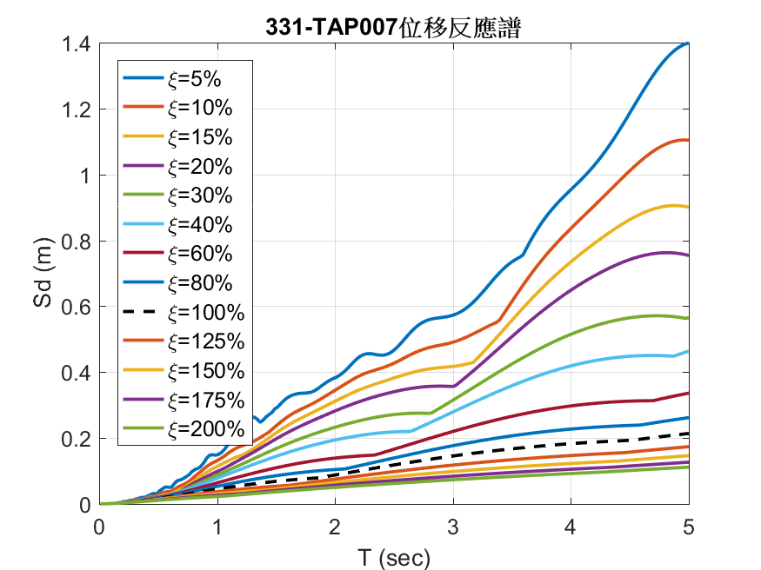
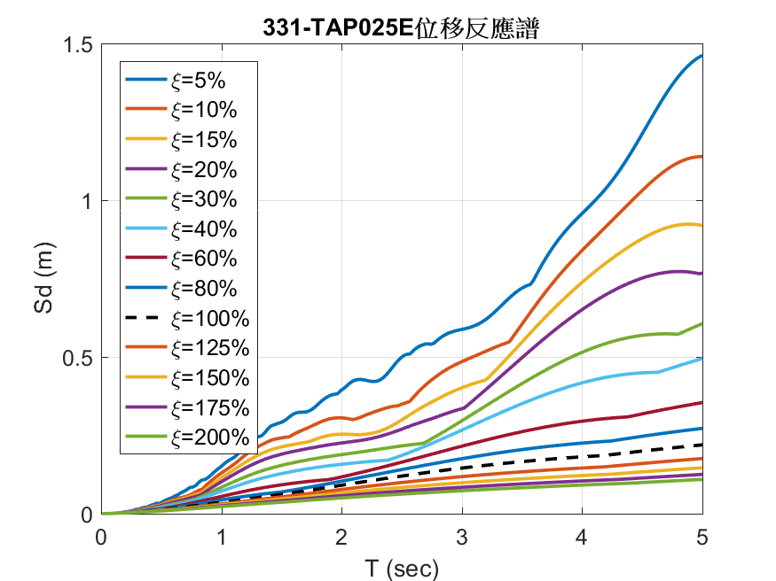
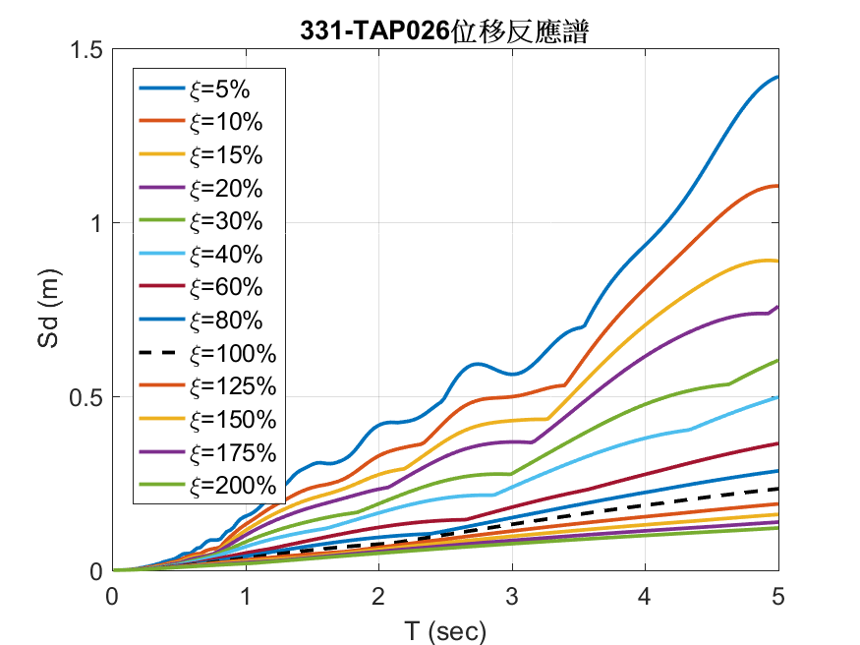
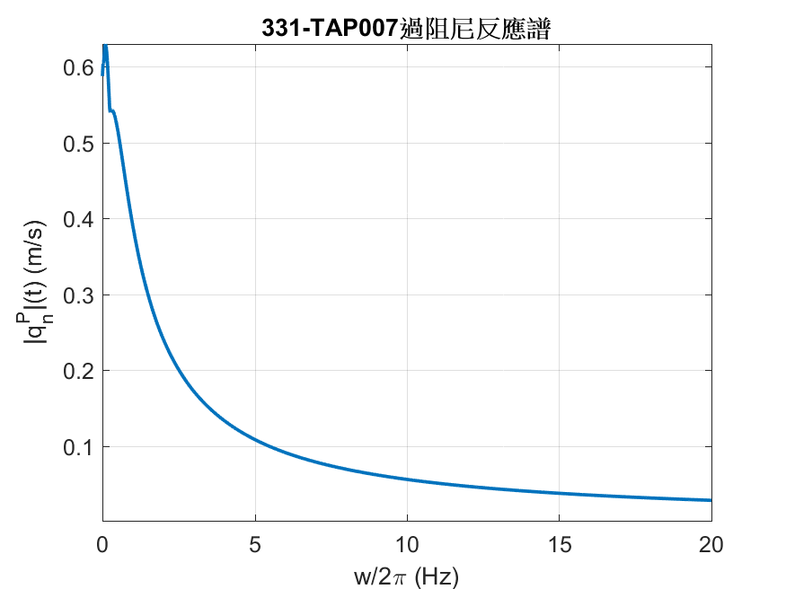
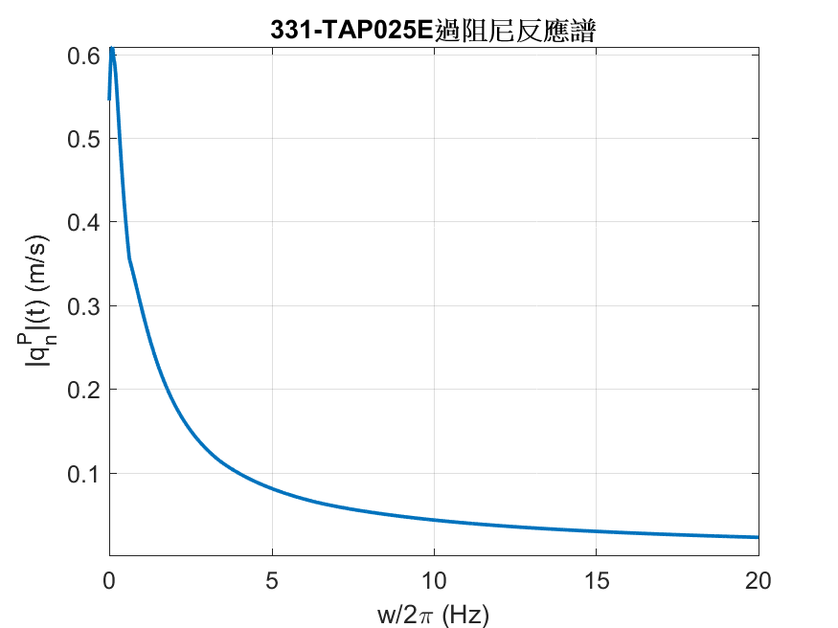
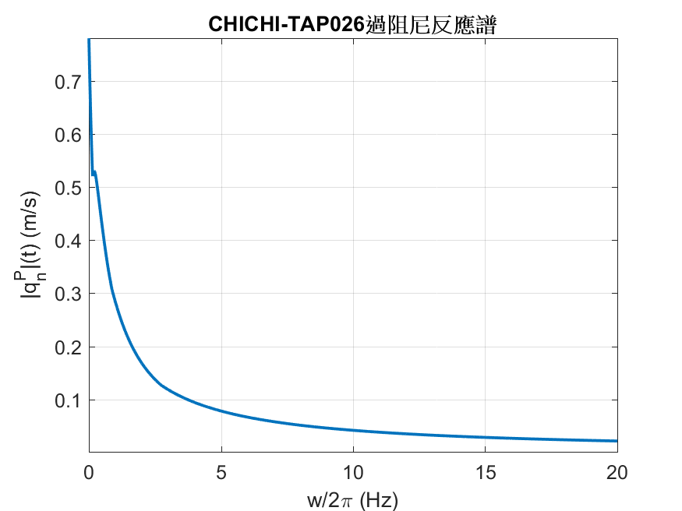

Slide 15
